Slide 1
Precept 2: TCP Congestion Control Review

Slide 2
TCP Basics
Q1: The size of the TCP Receive window never changes throughout the duration of the connection?
Notes:
True or false:

Slide 3
TCP Basics
Q1: The size of the TCP Receive window never changes throughout the duration of the connection?
Notes:
True or false:
FALSE.
RcvWindow is used to give the sender an idea of how much free buffer space is available at the receiver. Thus as the amount of unacknowledged TCP data varies the RcvWindow also changes.

Slide 4
TCP Basis
Q2: Suppose host A is sending a large file to host B over a TCP connection. The number of unacknowledged bytes that A sends cannot exceed the size of the advertised receiver buffer.
Notes:
TRUE.
TCP is not permitted to overflow the allocated receiver buffer. Hence when the sender can not send any more data RcvWindow would be 0 and hence all the buffer would have unacknowledged

Slide 5
TCP Basis
Q2: Suppose host A is sending a large file to host B over a TCP connection. The number of unacknowledged bytes that A sends cannot exceed the size of the advertised receiver buffer.
Notes:
TRUE.
TCP is not permitted to overflow the allocated receiver buffer. Hence when the sender can not send any more data RcvWindow would be 0 and hence all the buffer would have unacknowledged

Slide 6
Sender’s Window
Q3: A TCP connection is using a window size of 10 000 bytes, and the previous acknowledgment number was 22 001. It receives a segment with acknowledgment number 24 001. Draw a diagram to show the situation of the window before and after.

Slide 7
Q3: A TCP connection is using a window size of 10 000 bytes, and the previous acknowledgment number was 22 001. It receives a segment with acknowledgment number 24 001. Draw a diagram to show the situation of the window before and after.
Before acknowledgement
22000
24000
26000
28000
30000
32000
34000
36000

Slide 8
Q3: A TCP connection is using a window size of 10 000 bytes, and the previous acknowledgment number was 22 001. It receives a segment with acknowledgment number 24 001. Draw a diagram to show the situation of the window before and after.
Before acknowledgement
22000
24000
26000
28000
30000
32000
34000
36000

Slide 9
Q3: A TCP connection is using a window size of 10 000 bytes, and the previous acknowledgment number was 22 001. It receives a segment with acknowledgment number 24 001. Draw a diagram to show the situation of the window before and after.
Before acknowledgement
22000
24000
26000
28000
30000
32000
34000
36000
After acknowledgement
22000
24000
26000
28000
30000
32000
34000
36000

Slide 10
Q3: A TCP connection is using a window size of 10 000 bytes, and the previous acknowledgment number was 22 001. It receives a segment with acknowledgment number 24 001. Draw a diagram to show the situation of the window before and after.
Before acknowledgement
22000
24000
26000
28000
30000
32000
34000
36000
After acknowledgement
22000
24000
26000
28000
30000
32000
34000
36000

Slide 11
Q4: TCP waits until it has received three duplicate ACKs before performing a fast retransmit. Why do you think the TCP designers chose not to perform a fast retransmit after the first duplicate ACK for a segment is received?
Notes:
Answer: Packets can arrive out of order from the IP layer. So whenever an out of order packet would be received it would generate a duplicate ACK and if we perform retransmission after the first duplicate ACK it would lead the sender to introduce too many redundant packets in the network.

Slide 12
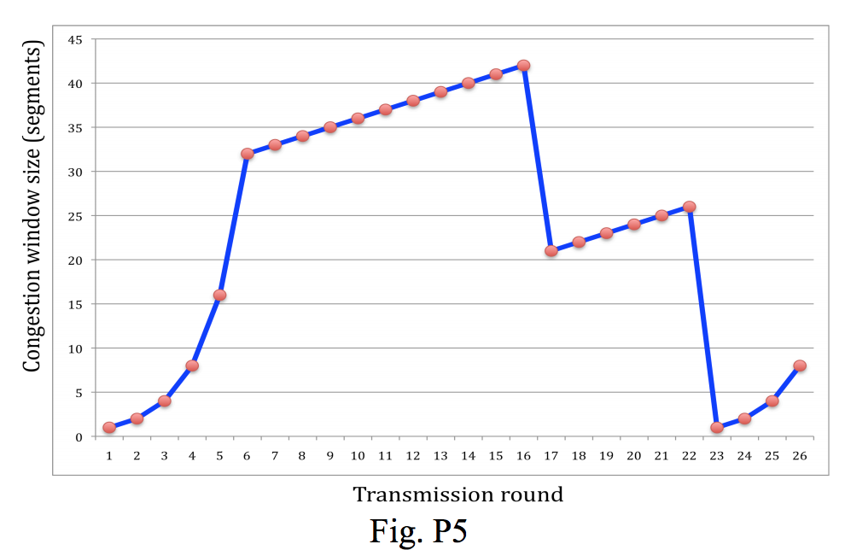
Q5: Identify the interval of time when TCP slow start is operating.
Notes:
TCP slowstart is operating in the intervals [1,6] and [23,26]

Slide 13
Q6: Identify the interval of time when TCP congestion avoidance is operation.
Notes:
TCP congestion avoidance is operating in the intervals [6,16] and [17,22]

Slide 14
Q7: After the 16th transmission round, is segment loss detected by a triple duplicate ACK or by a timeout?
Notes:
After the 16th transmission round, packet loss is recognized by a triple duplicate ACK. If there was a timeout, the congestion window size would have dropped to 1.

Slide 15
Q8: After the 22nd transmission round, is segment loss detected by a triple duplicate ACK or by a timeout?
Notes:
After the 22nd transmission round, segment loss is detected due to timeout, the TCP enters slow start, and hence the congestion window size is set to 1.

Slide 16
Q9: What is the initial value of ssthresh at the first transmission round?
Notes:
The threshold is initially 32, since it is at this window size that slow start stops and congestion avoidance begins.

Slide 17
Q10: What is the value of ssthresh at the 18th transmission round?
Notes:
The threshold is set to half the value of the congestion window when packet loss is detected. When loss is detected during transmission round 16, the congestion windows size is 42. Hence the threshold is 21 during the 18th transmission round.

Slide 18
Q11: What is the value of ssthresh at the 24th transmission round?
Notes:
The threshold is set to half the value of the congestion window when packet loss is detected. When loss is detected during transmission round 22, the congestion windows size is 26. Hence the threshold is 13 during the 24th transmission round.

Slide 19
Q12: During what transmission round is the 70th segment sent?
Notes:
During the 1st transmission round, packet 1 is sent; packet 2-3 are sent in the 2nd transmission round; packets 4-7 are sent in the 3rd transmission round; packets 8-15 are sent in the 4th transmission round; packets 16-31 are sent in the 5th transmission round; packets 32-63 are sent in the 6th transmission round; packets 64 – 96 are sent in the 7th transmission round. Thus packet 70 is sent in the 7th transmission round

